Slide 1
Data Structure:-
It is a way to organize the data in some way so we can do the operations on these data in effective way. Data structure may be organized in many different ways. The logical or mathematical model of a particular organization of data is called data structure.

Slide 2
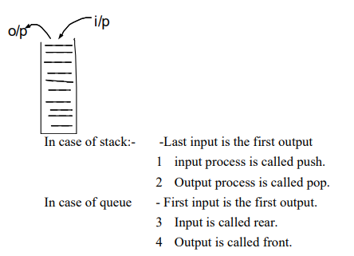
Data structure can be classified as:-
1. Linear data structure:- Processing of data items by linear fashion is linear data structure e.g. array, stack, queue, linked list.

Slide 3
2. Non Linear data structure:-
A data structure in which insertion and deletion is not possible in a linear fashion is called non –linear data structure. E.g. tree, graph

Slide 4
Abstract Data type (ADT):-
ADT is used to specify the logical properties of the data type. It is a set of operation which is called with the component of the element of that abstract data type.

Slide 5
Operations
Insertion
Deletion
Search
Display

Slide 6
Goals of data structure:-
Data structure involves two complementary goals:-
identify and develop useful mathematical entities and operations and determine what class of problems can be solved by using these entities and operations.
Determine representation for those abstract entities and implement the abstract operations on these concrete representations.

Slide 7
Properties of Data structure:-
Generalization:- Entity generalizes the primitive data type (integer, real, float)
Encapsulation:- All the operation of that type can be localized to one section of program.

Slide 8
Asymptotic NOtation
Presentation 1

